Slide 1


Are we creatures of habit?
Reproducibility of accelerometer-derived physical activity and sleep in the UK Biobank
Charilaos (Harry) Zisou, DPhil Student University of Oxford
Contributions: Hannah Taylor^{1,2}, Ben Lacey^{1,2}, Imen Hammami¹, Rosemary Walmsley¹, Tessa Strain³, Katrien Wijndaele³, Karl Smith-Byrne¹, Derrick Bennett¹, Sarah Lewington¹, Jemma C. Hopewell^{1†}, Aiden Doherty^{1†}
† Equal contributions
Affiliations:
1.Nuffield Department of Population Health, University of Oxford, Oxford, UK
2.UK Biobank, Stockport, UK
3.MRC Epidemiology Unit, University of Cambridge, Cambridge, UK
charilaos.zisou@ndph.ox.ac.uk
HRfH Connect Research Showcase 07-February-2025

Slide 2
Wearables in large-scale epidemiological studies
Device-based measurements provide novel insights into associations of physical activity and sleep with health outcomes
Cohort studies typically instruct participants to wear an accelerometer for 7 days
Research questions:
Can a single 7-day accelerometer measurement capture someone’s usual physical activity and sleep patterns?
How does within-person variation in physical activity and sleep affect their associations with future health outcomes?

Slide 3

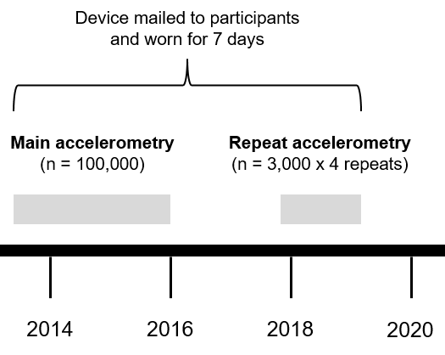
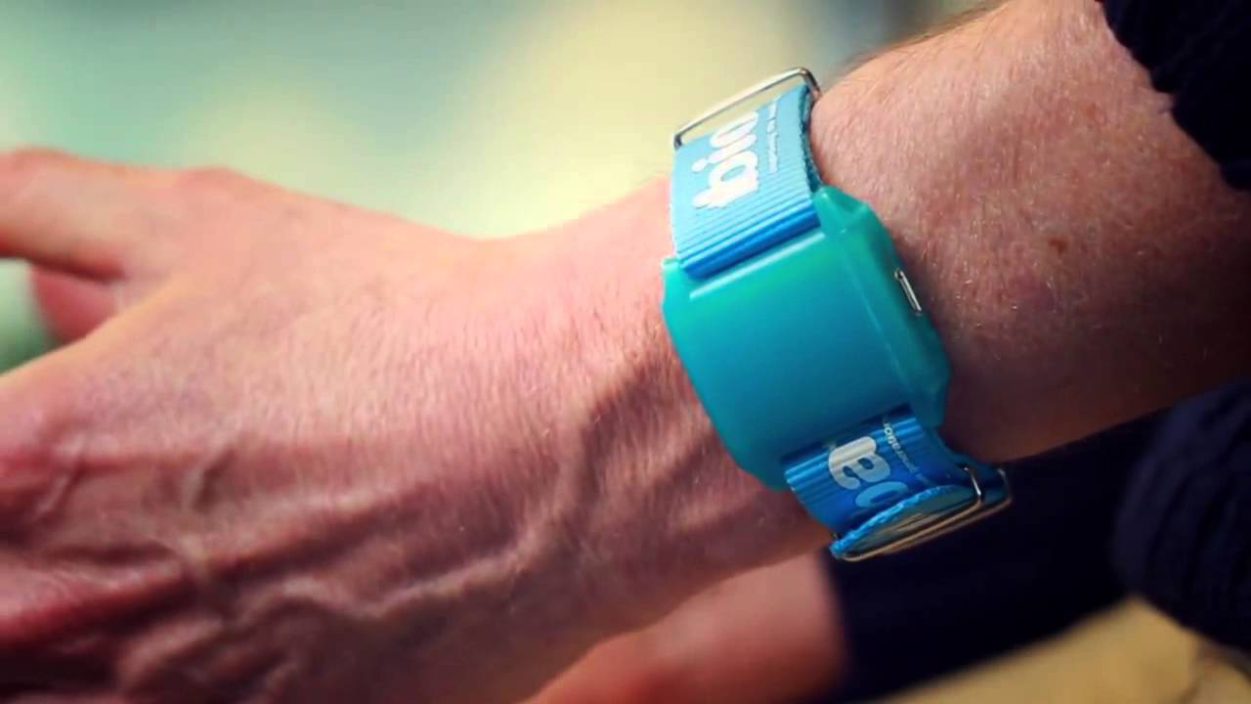
UK Biobank repeat accelerometry sub-study
Investigated nine physical activity and sleep phenotypes
Extracted using validated machine learning models developed by the Oxford Wearables Group (https:/github.com/OxWearables)
Assessed agreement between measurements taken ~3.7 years apart (reproducibility)
Tracked changes in activity/sleep levels within baseline-defined fifths
Estimated intraclass correlation coefficients (ICCs)

Slide 4
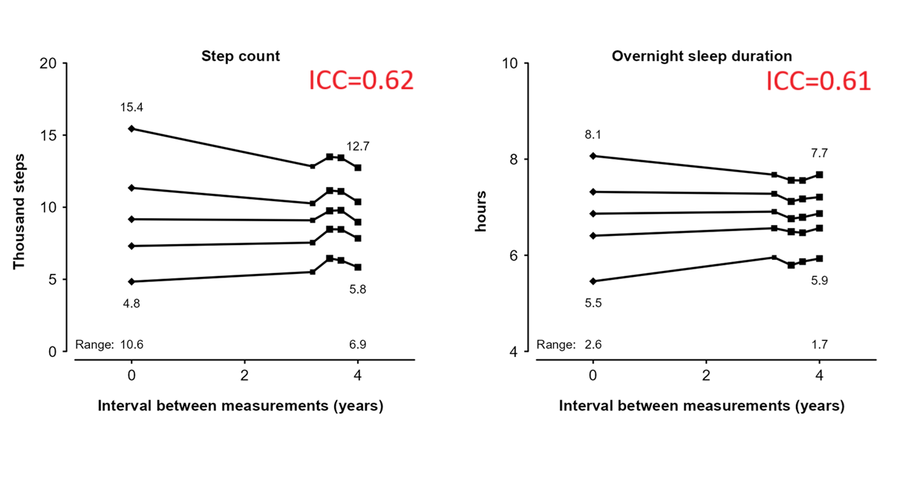
Changes in accelerometer-derived phenotypes of physical activity and sleep within fifths defined by first measurements
Mean levels of physical activity and sleep moderately converged after 4 years (regression towards the mean)
Remaining phenotype ICCs ranged from 0.58 (sleep efficiency) to 0.75 (overall activity)

Slide 5
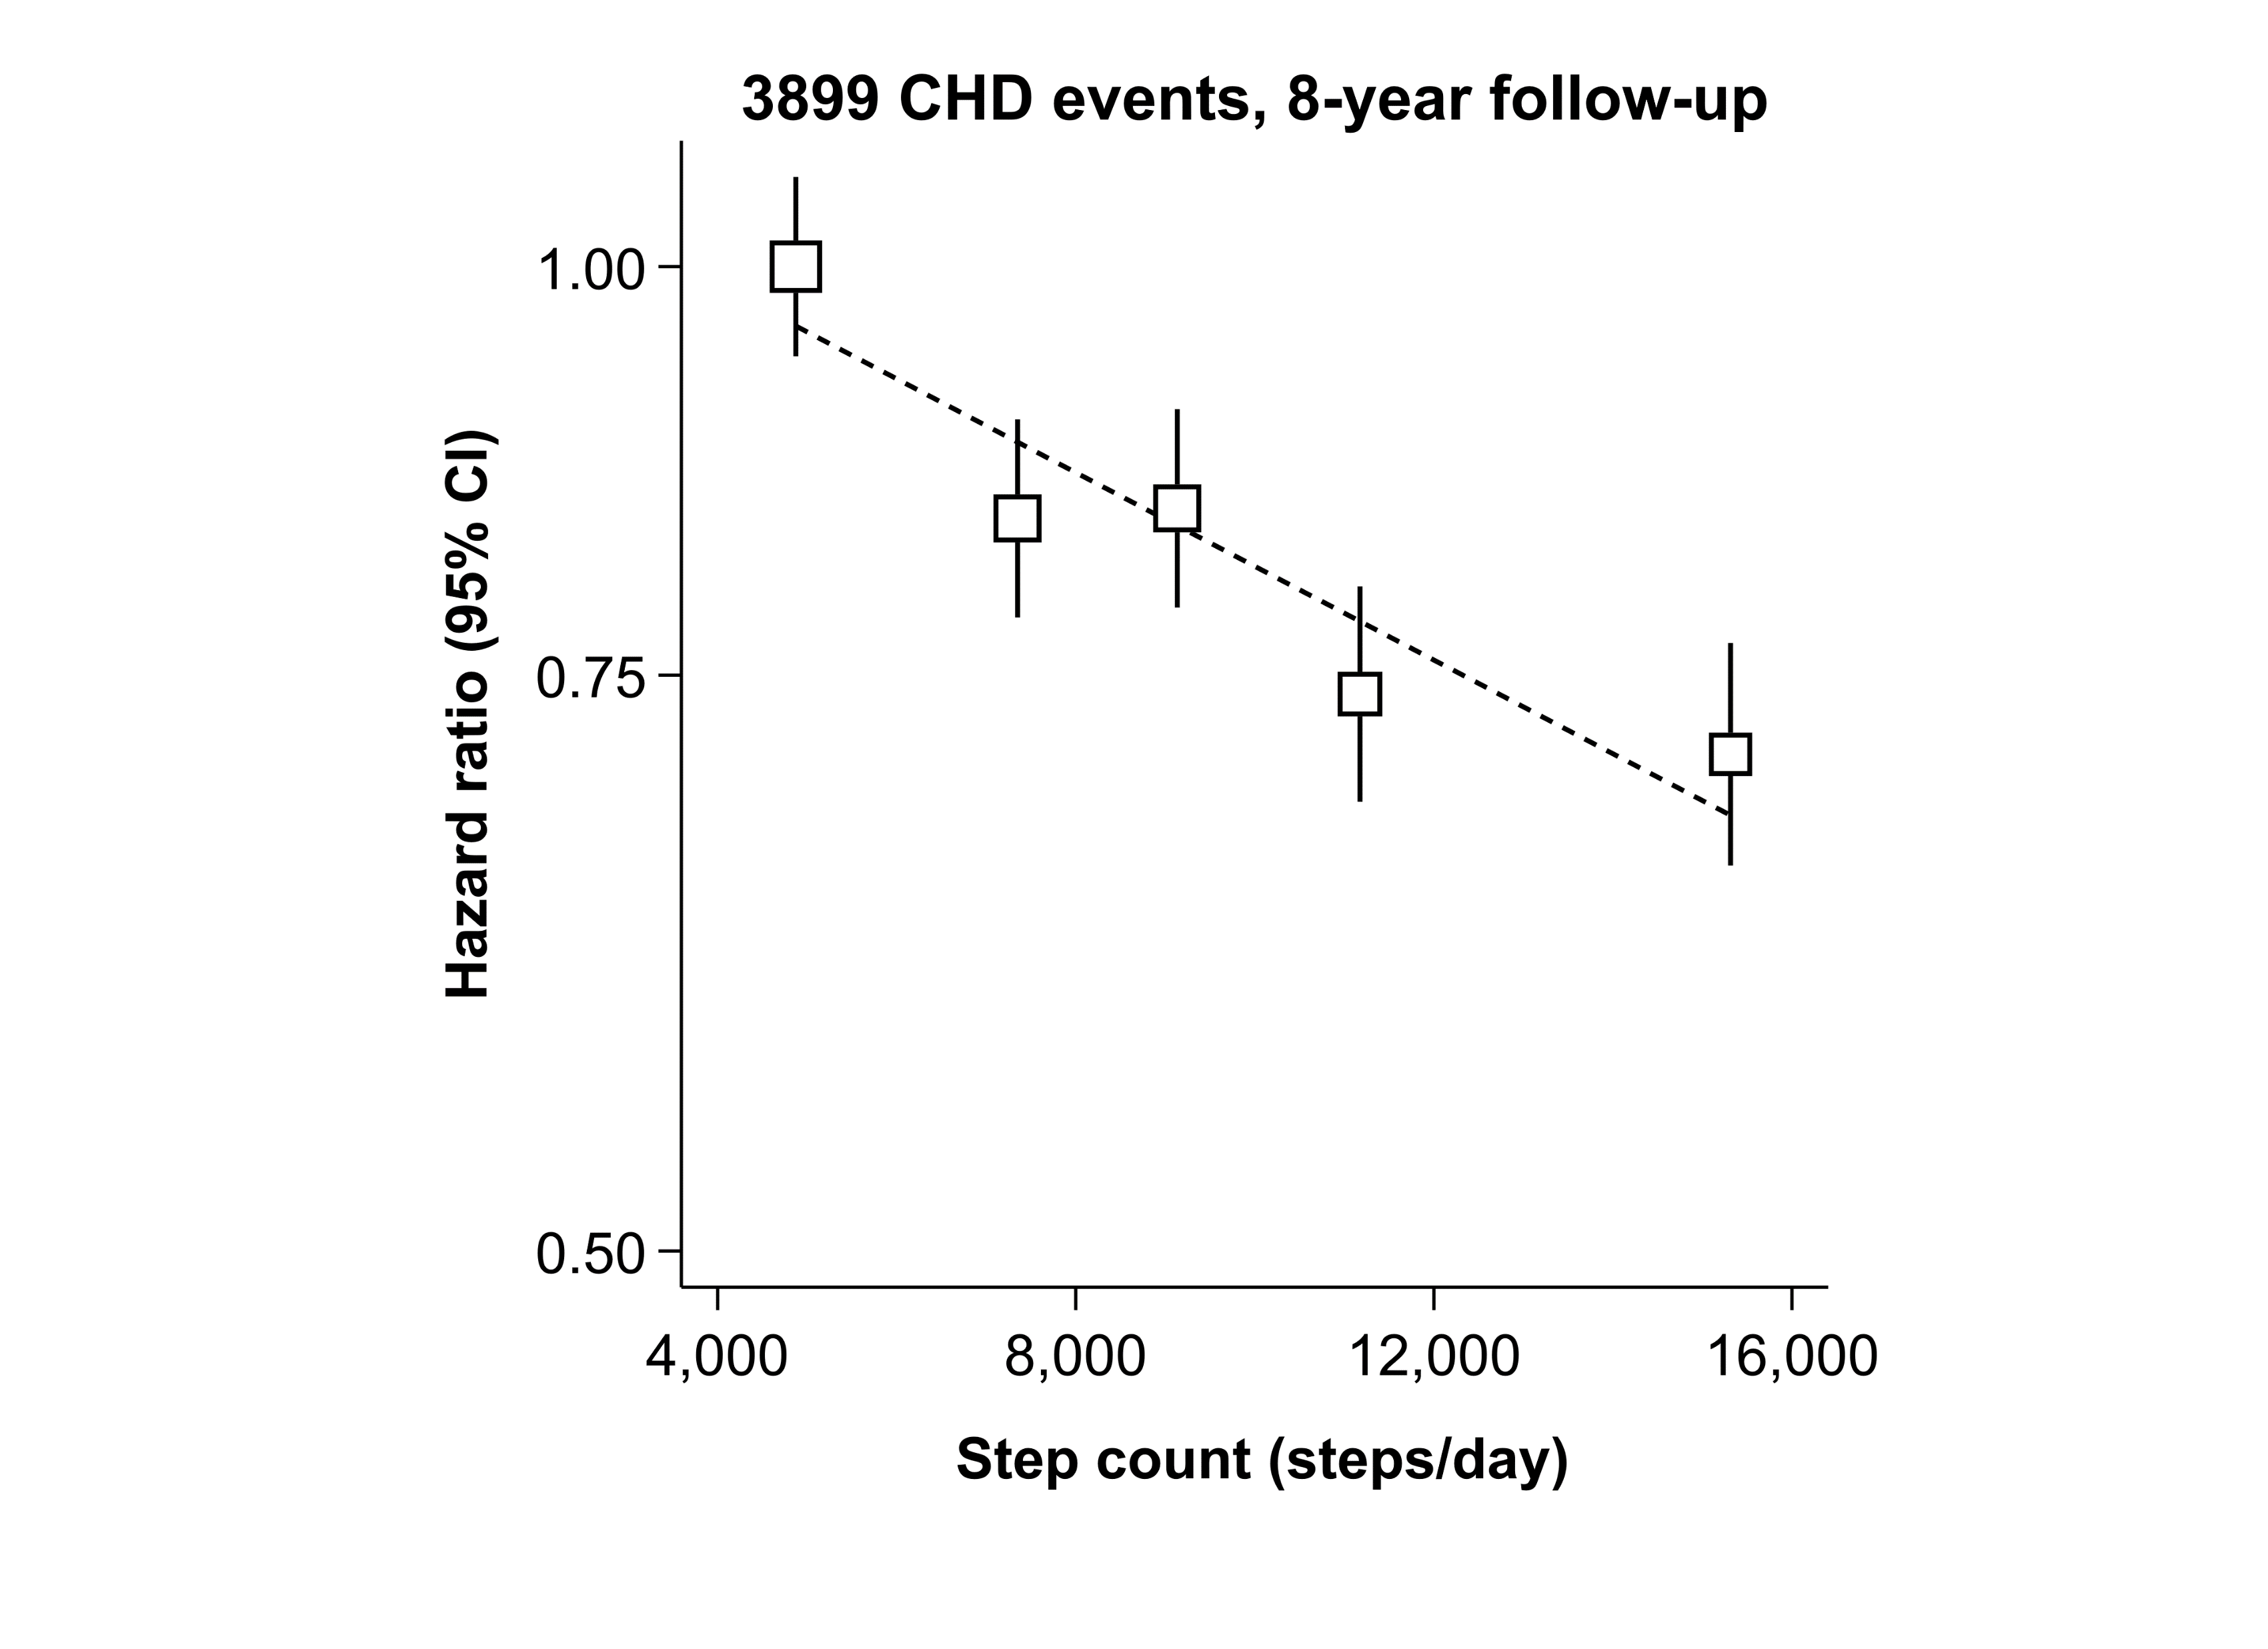
Impact of within-person variation on association between daily step count and coronary heart disease (CHD) – regression dilution bias
Before correction for regression dilution bias:
Every 4,000 steps →13% lower risk of CHD

Slide 6
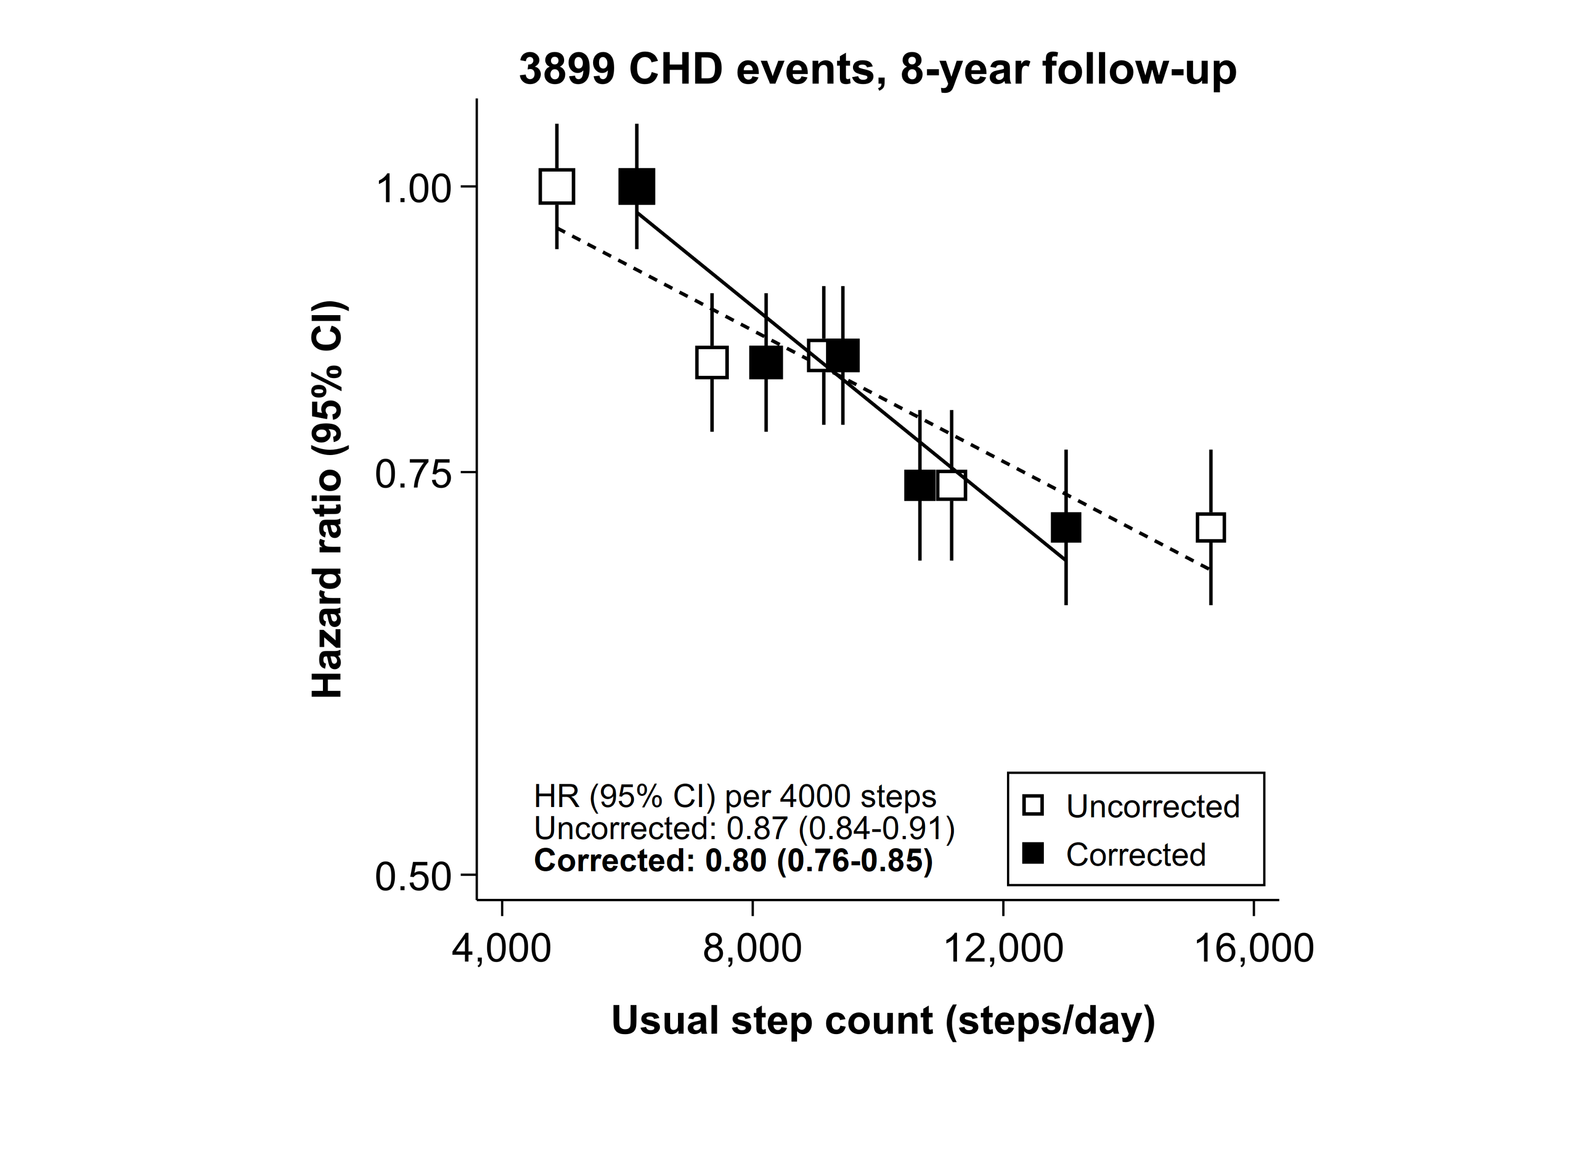
Impact of within-person variation on association between daily step count and coronary heart disease (CHD) – regression dilution bias
Before correction for regression dilution bias:
Every 4,000 steps →13% lower risk of CHD
After correction for regression dilution bias:
Every 4,000 usual steps → 20% lower risk of CHD

Slide 7

Conclusions and implications
Preprint:
tinyurl.com/ukb-repeat-accelerometry
Seven-day accelerometer measurements exhibit moderate to good long-term reproducibility
Previous studies have likely underestimated associations with health outcomes
Highlights the need for:
cohort studies to incorporate repeat accelerometer measurements
researchers to use appropriate methods to account for regression dilution bias

